Slide 1

School of Business
OPIM 5671 – Data Mining and Business Intelligence
Text Mining Project
Glassdoor Employee Reviews Sentiment Analysis
Group 3
Aniket Jana, Pratiksha Nimesh, Kaman Dhami, Meghna Ashok,
Haneesha Balireddy, Kushagra Goyal

Slide 2
Background
Companies today rely heavily on modeling techniques to predict employee retention
This helps companies to be prepared for employee allocation, hiring, and future projects planning
In our project we perform various text mining models to perform a sentiment analysis on employee reviews for Amazon and Microsoft employees on Glass door
Our aim is to bucket the reviews into negative and positive reviews along with finding useful insights for the HR department, in order to devise strategies for customer retention as well as improve the company's public relations.

Slide 3
Agenda
About the Project and Data
Data Pre-processing
Data Exploration
Modeling – Amazon Reviews
Modeling – Microsoft Reviews
Recommendations

Slide 4
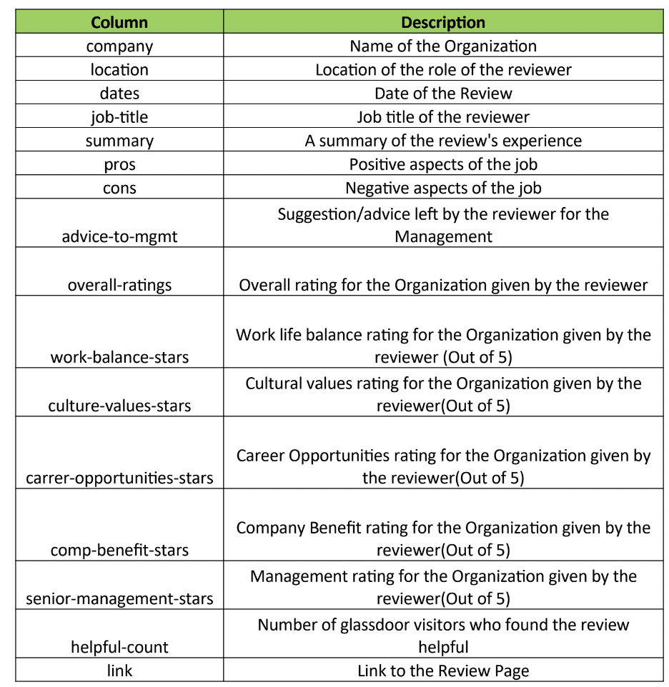
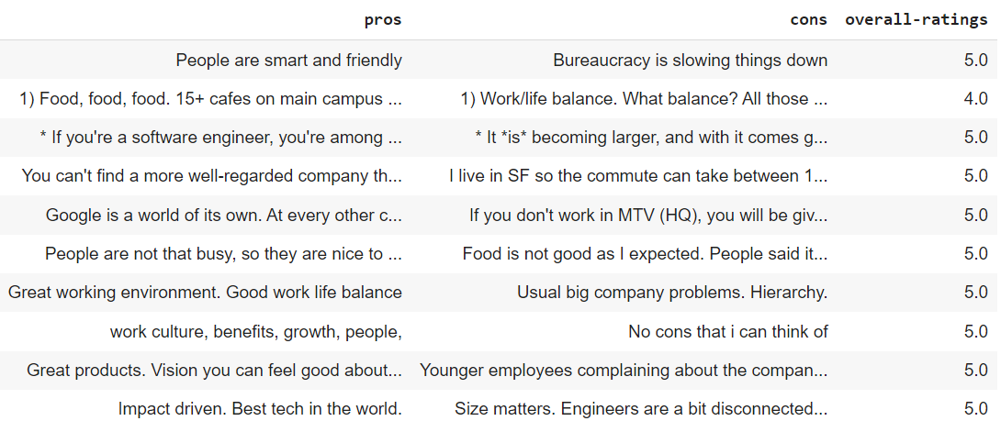
Data Overview
The dataset contains employees for companies such as Amazon, Google, Apple, Facebook, Microsoft, and Netflix ranging between April 2009 and September 2018.
Data set is huge and has 67k records in it.
However, for our project, we’ll be creating a subset of two companies: Amazon and Microsoft.
Make a recommendations to increase employee engagement and
retention based on the positive and negative reviews
Initial Data set

Slide 5
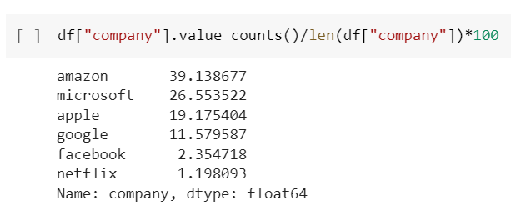
Data Pre-processing
Removed Missing values and 'None' entries
Imputed Median for Missing ratings
Converted data types
Rescaled data with Pros, Cons and Ratings for building Unsupervised learning model for deriving recommendations.
Rescaled data for Modeling purposes : Pros kept for Ratings >= 4. Cons kept for Ratings <4.
AMAZON
Pros(1) : 8090 rows.
Cons(0) : 8025 rows
MICROSOFT
Pros(1) : 5063 rows.
Cons(0) : 5766 rows

Slide 6
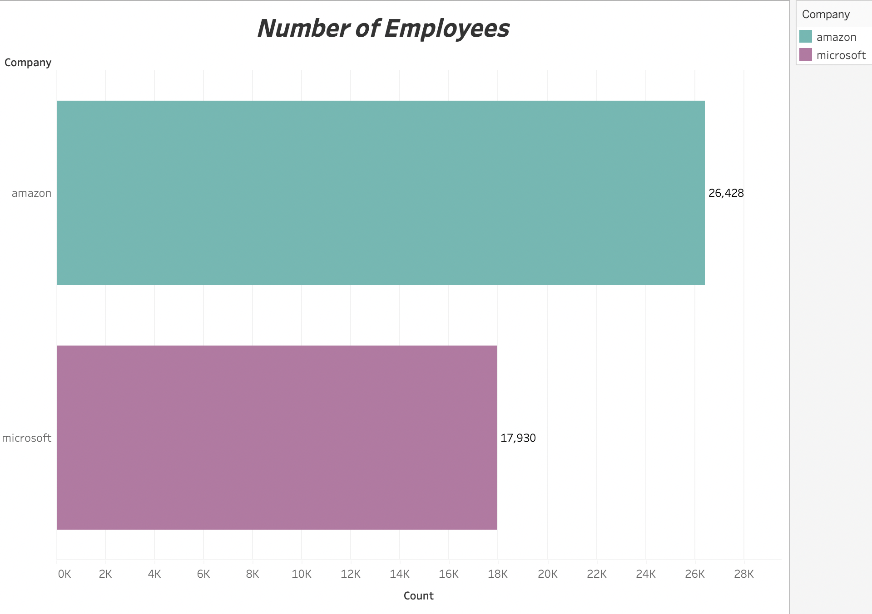
Total number of employee reviews

Slide 7
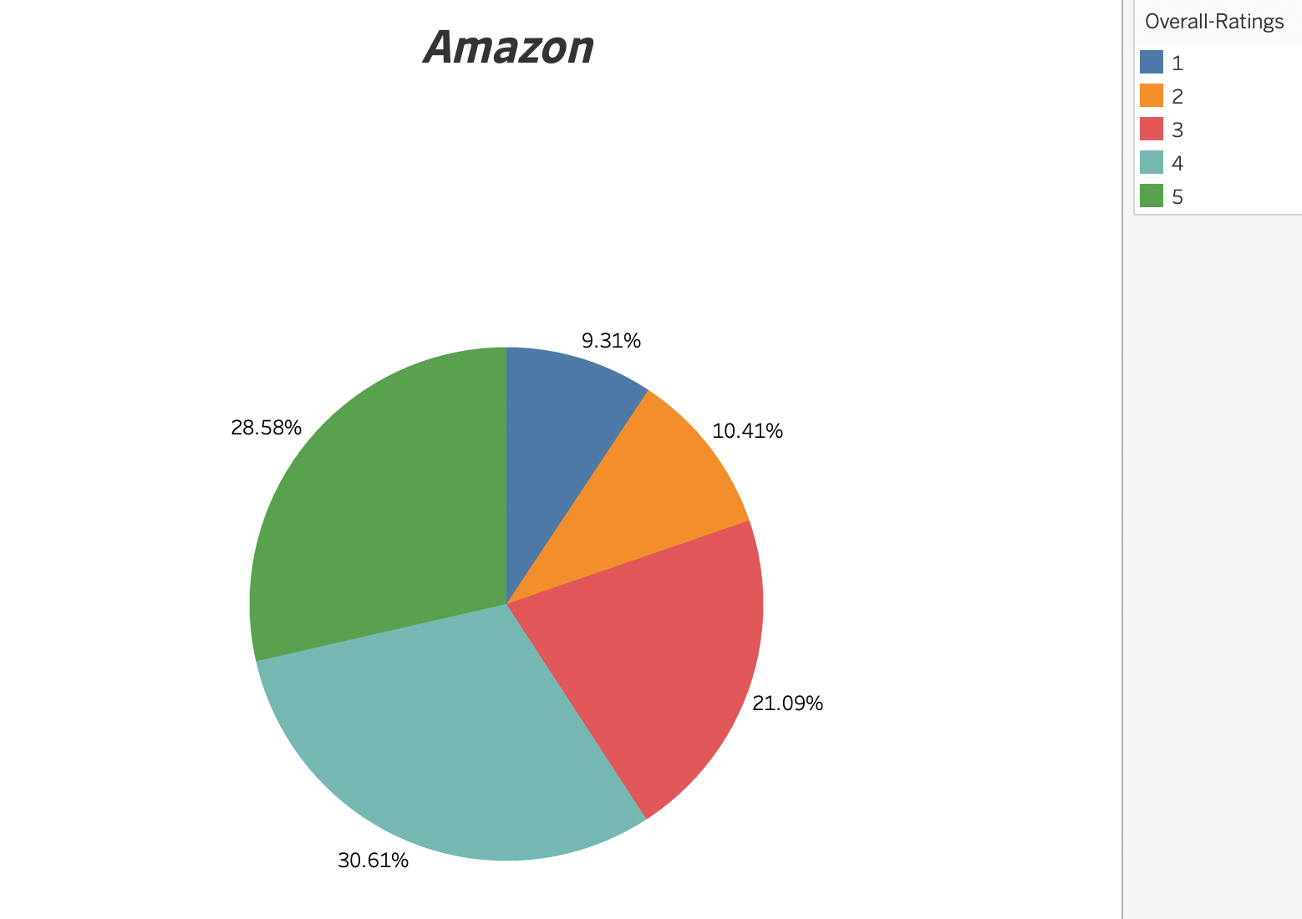
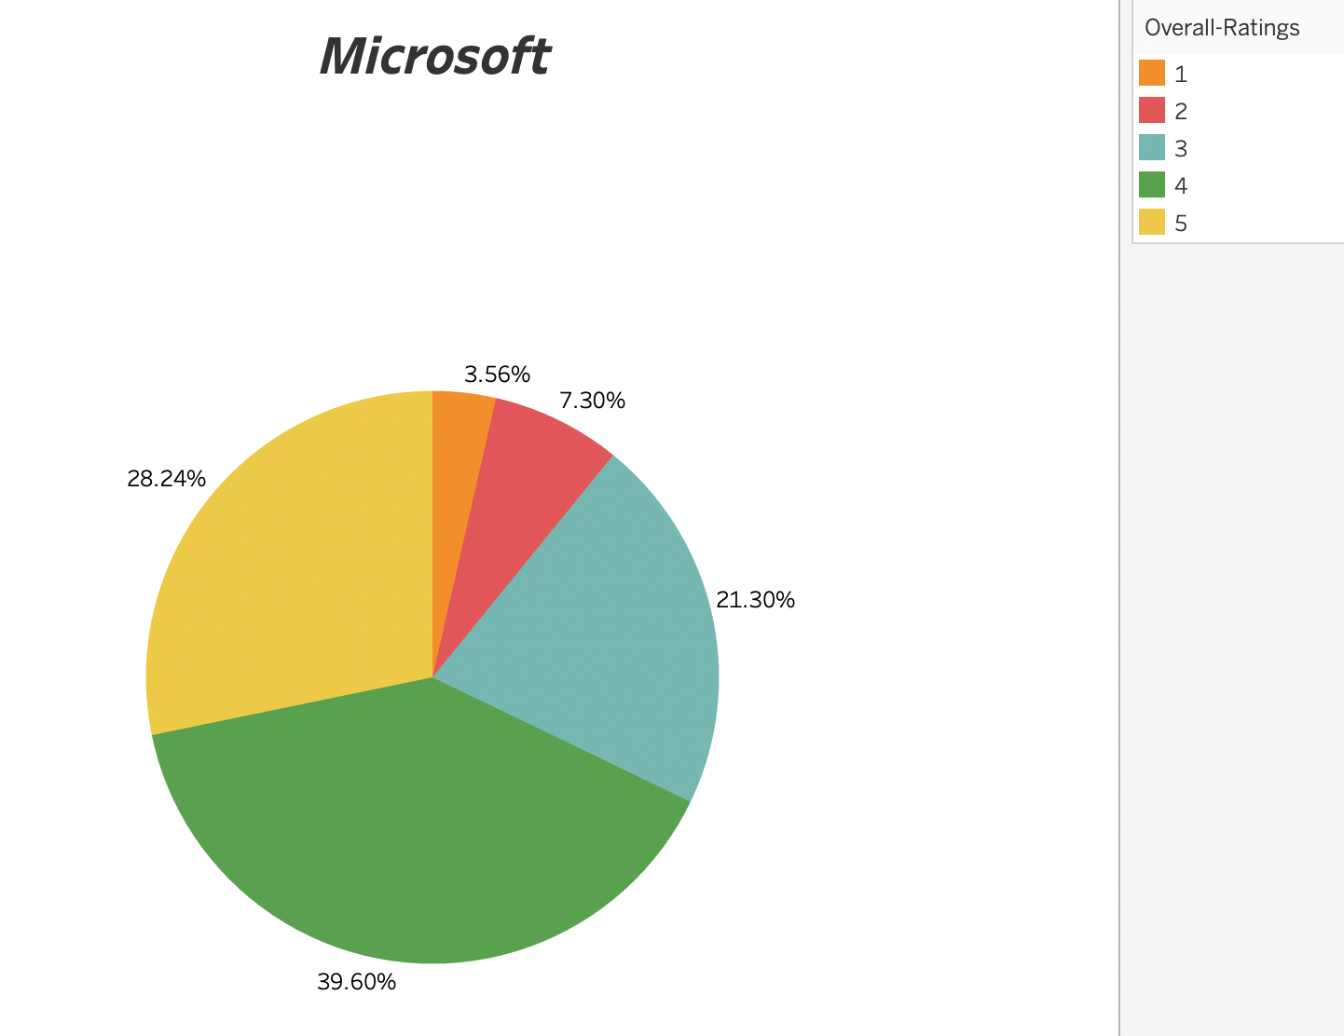
Overall Ratings by Company

Slide 8
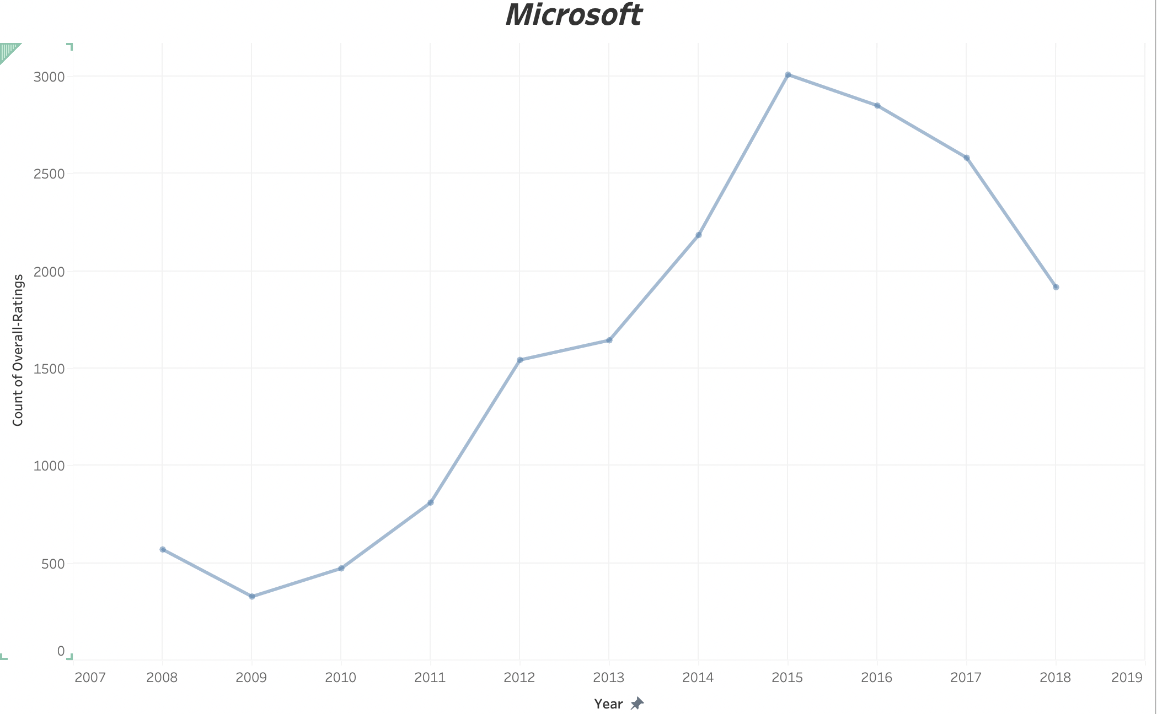
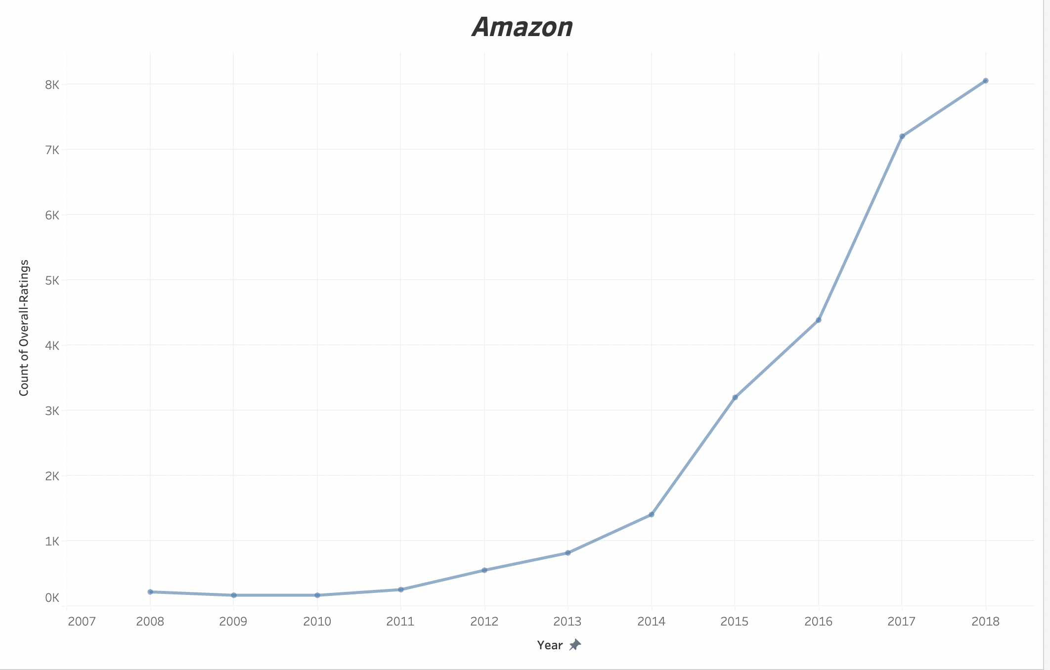
Review Count over the years

Slide 9
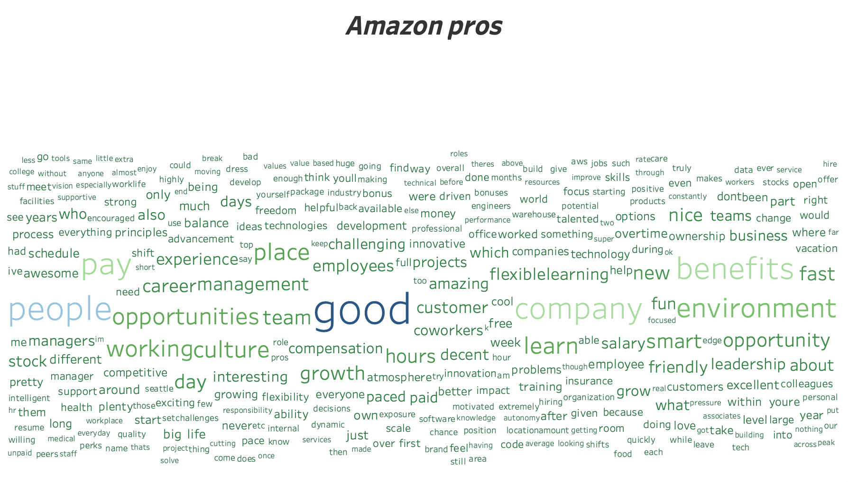
Amazon- Word Cloud

Slide 10
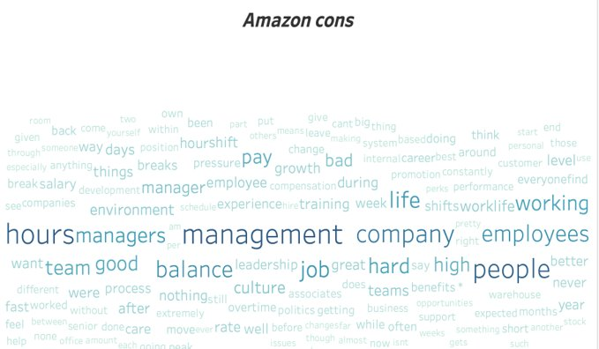
Amazon- Word Cloud

Slide 11
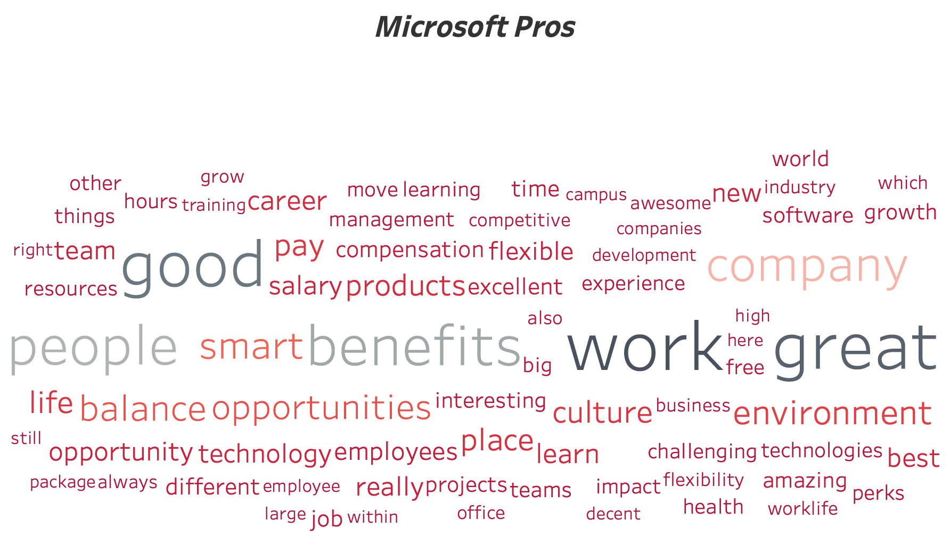
Microsoft- Word Cloud

Slide 12
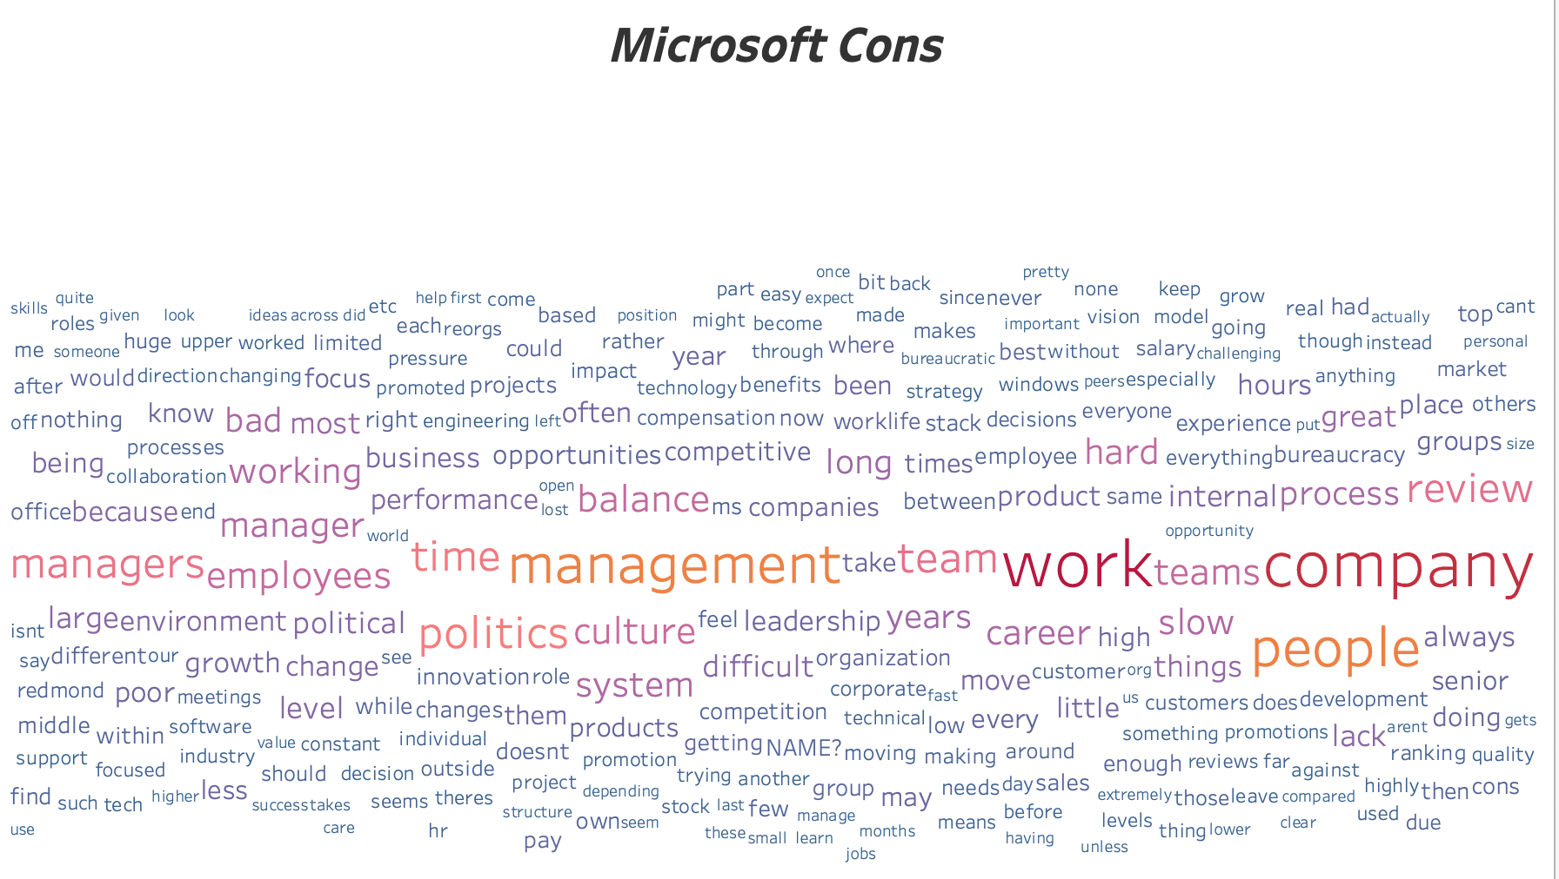
Microsoft- Word Cloud

Slide 13
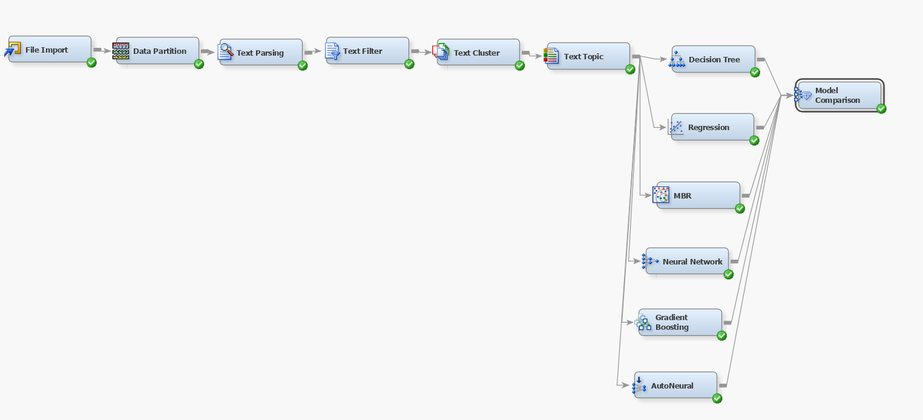
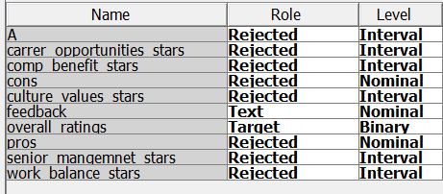
Modeling: Amazon reviews

Slide 14
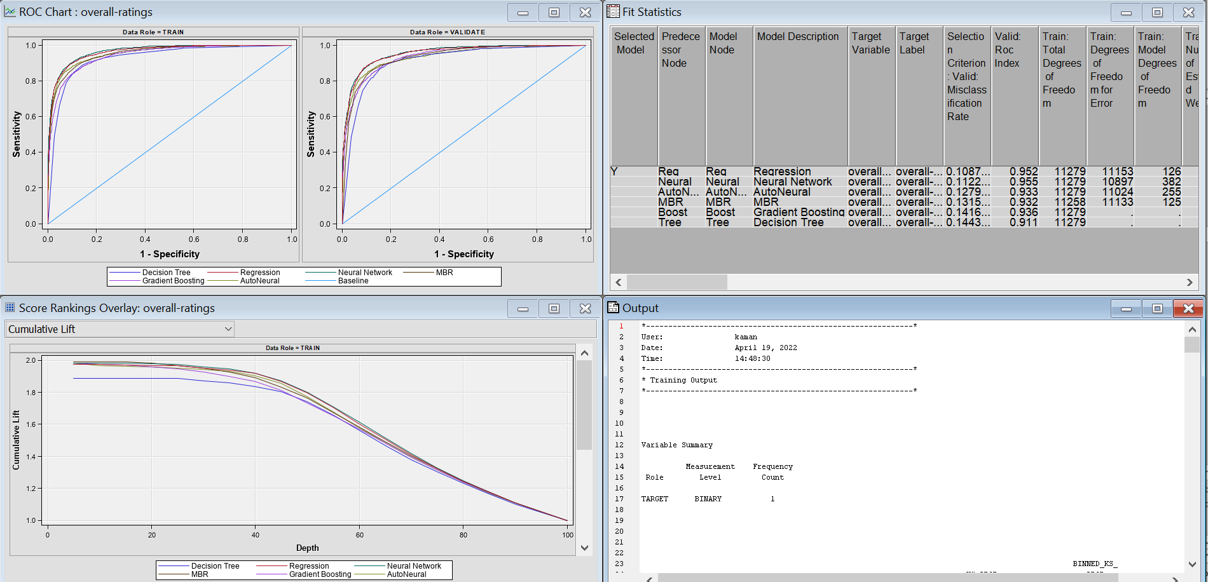
Model Statistics ROC

Slide 15
Confusion Matrix

Slide 16
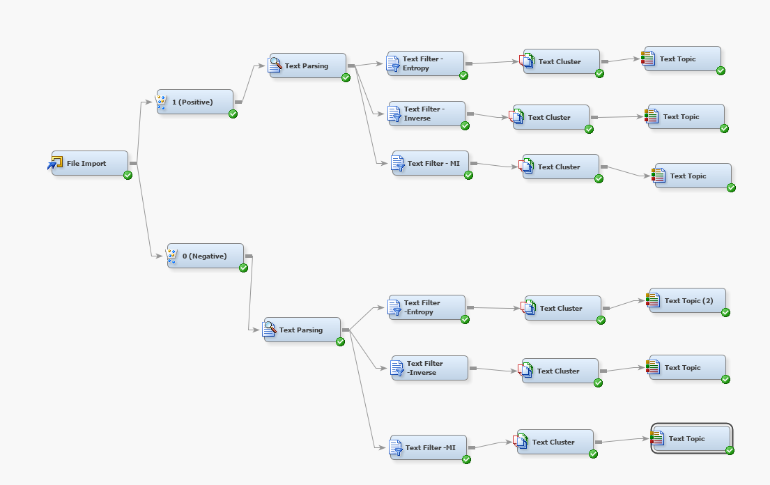
Amazon Reviews Analysis
Notes:
For Amazon...2 models.
1. Unsup...analyzing the clusters and topics.
We have segregated it into pros and cons accordingly for the sake of analysis.
What we found is....good differentiation in our clusters. For both pros and cons.

Slide 17
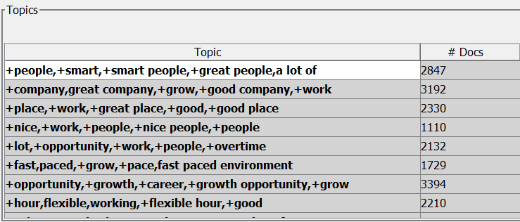
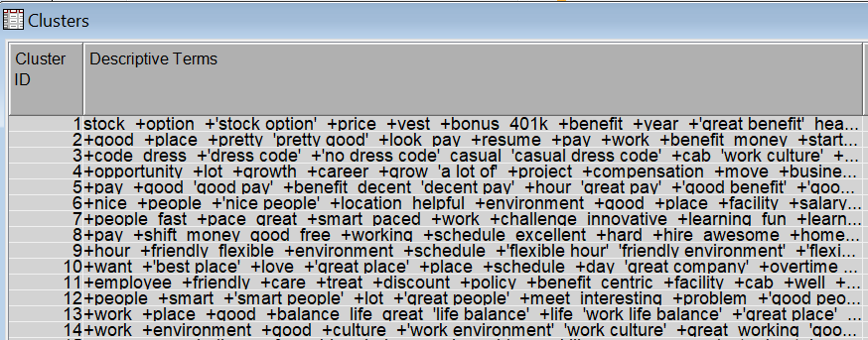
PROS

Slide 18
Text Cluster Analysis
Cluster Theme | Descriptive Terms
Benefits | stock +option +'stock option' +price +vest +bonus 401k +benefit +year +'great benefit' health +insurance +compensation dental +discount
No dress code | +code dress +'dress code' +'no dress code' casual 'casual dress code' +cab 'work culture' +policy free +culture +friendly +facility 'friendly environment' +environment
Fast pace/Innovation | +fast paced +environment +pace 'fast paced environment' +'fast pace' +grow fast +challenge +'work environment' +opportunity innovative +learning +impact +growth +innovation
Customer focus/obsession | +customer +focus obsession +service centric +impact 'customer obsession' +obsess +company +strong +product +value +business +care +smart
Team +Leadership | +team +dynamics +'great team' +depend different +find +'project team' +move +experience 'a lot of' +impact leadership team +build excellent +learn
Work life balance | +work +place +good +balance life great 'life balance' +life 'work life balance' +'great place' work +'best place' +'good place' +best awesome
Notes:
For every cluster we got...we tried to pick a common theme or infer what the descriptive terms was talking about.
And for every theme we got...we verified it with our text topics as well.
Fast paced env + innovative + leads to growth and personal devp.
Customer obsession...which shows how driven they are to serving customers.
130 userrs.

Slide 19
Text Cluster Analysis
Cluster Theme | Descriptive Terms
Smart people | +people +smart +'smart people' +lot +'great people' +meet interesting +problem +'good people' 'smartest people' +challenge talented 'a lot of' +great +project
Cutting edge technology | +experience +technology +learning +edge cutting +'edge technology' +'learning experience' +'new technology' curve 'learning curve' +late +gain +learn +resume +great
Friendly + Flexible staff/environment | +hour +friendly flexible +environment +schedule +'flexible hour' 'friendly environment' +'flexible schedule' +staff helpful +'work hour' +shift working +'good hour' +pay
Work environment/culture | +work +environment +good +culture +'work environment' 'work culture' +great working 'good working environment' +'good environment' +pressure +facility +friendly +growth casual
Good salary + Benefits | pay +good +benefit +great decent 'good pay' +environment 'decent pay' +'good benefit' +'great benefit' +hour +'work environment' 'great pay' +salary health
Notes:
Text topics giving us the exact same themes.

Slide 20
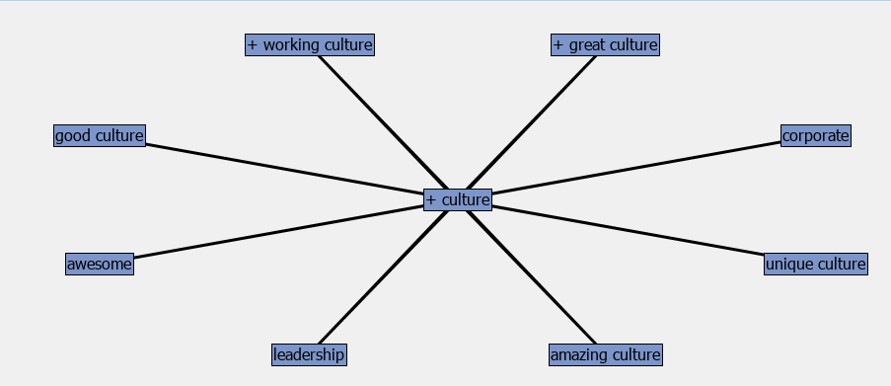
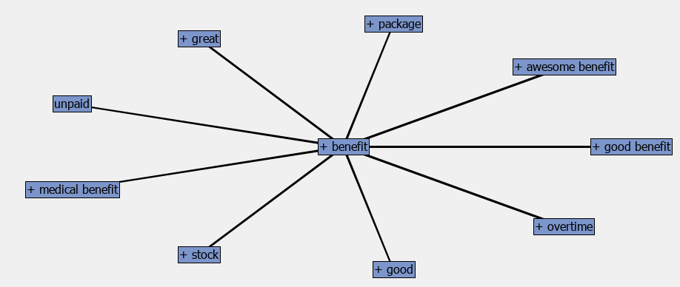
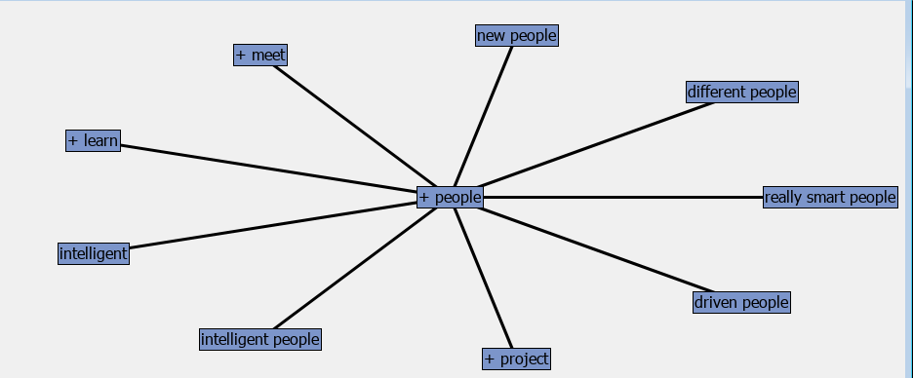
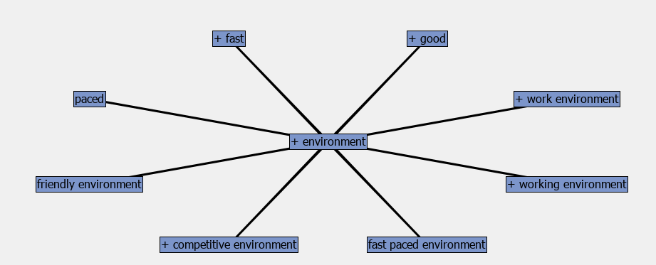
Key Concept Links

Slide 21
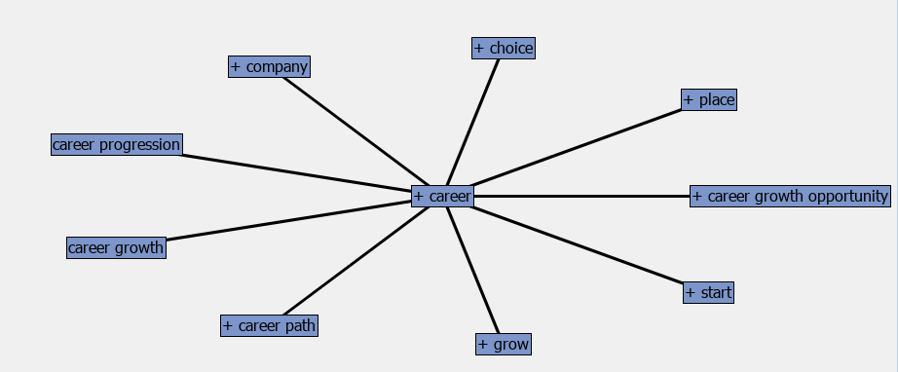
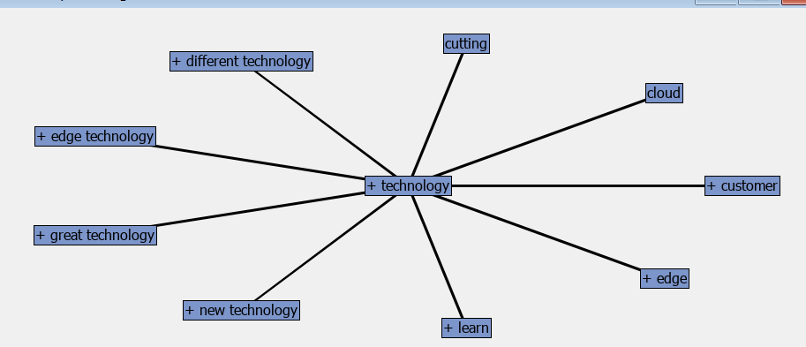
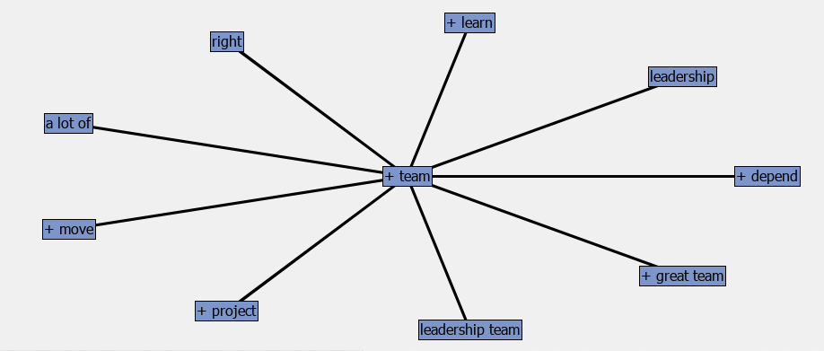
Key Concept Links
Notes:
What are the postive reviews the employees have regd Amazon

Slide 22
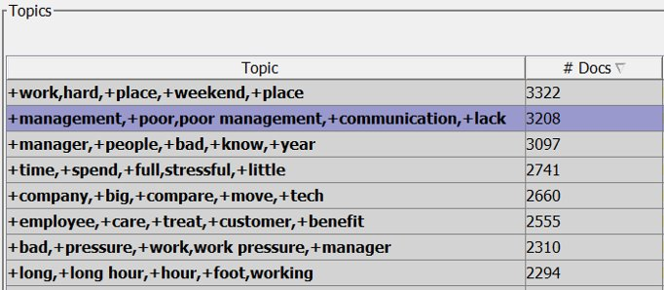
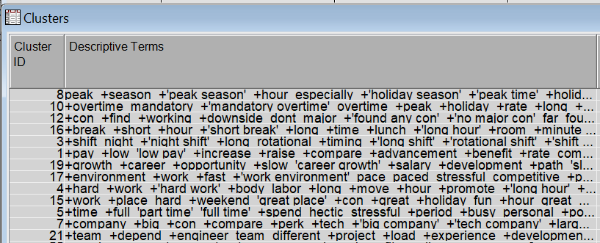
CONS

Slide 23
Text Cluster Analysis
Cluster Theme | Descriptive Terms
Low Pay/Salary | +pay +low +salary +compare 'low pay' +increase +hike +'low salary' base +structure +little +raise +mediocre +growth
Poor Management + Favoritism/ | +management +poor +bad upper +lack 'upper management' 'poor management' +communication 'bad management' senior 'senior management' favoritism +staff politics horrible
Shifts : Night shift, Rotational | +shift night +'night shift' +long rotational +timing +'long shift' +'rotational shift' +'shift timing' +hour flexible +early +night +weekend +week
Peak + Holiday Season extra hours | peak +season +'peak season' +hour especially +'holiday season' +'peak time' +holiday +long mandatory +week +'long hour' +overtime demanding hectic
Fast paced + Stressful Environment | +environment +work +fast +'work environment' pace paced stressful competitive +pace 'fast pace' 'fast paced environment' fast working demanding +challenge +stress +pressure
Mandatory Overtime | +overtime mandatory +'mandatory overtime' overtime +peak +holiday +rate +long +hour +day +shift labor +season +'long hour' +week
Notes:
Poor mgmt...fav and politics esp between the upper/sr mgmt.
Ppls complained of night shifts./...long, rotational and extending to weekends and holidays.
Demanding , hectic

Slide 24
Text Cluster Analysis
Cluster Theme | Descriptive Terms
Long work hours (Physically demanding) | +hour +long +'long hour' +work +day +week +foot working +stand physically +'work hour' +walk +peak walking demanding
Short breaks | +break +short +hour +'short break' +long +time +lunch +'long hour' +room +minute +walk minute +'break room' +foot
Work life balance | +work +balance life +'life balance' +life +'work life balance' +poor +maintain 'balance can' 'no work' work hectic +pressure +challenge difficult
Slow career growth/promotion opportunities | +growth +career +opportunity +slow 'career growth' +salary +development +path 'slow growth' +'growth opportunity' limited slow +limit +room +promotion

Slide 25
Discrepancies
Work life balance in Pros : Frequency: 118 #documents : 117 Work life balance in Cons: Frequency: 364 #documents : 358
Salary(High) in Pros : Frequency: 232 #documents : 232 Salary(Low) in Cons: Frequency: 30 #documents : 30
Fast paced Environment in Pros : Frequency: 153 #documents : 153
Fast paced Environment in Cons : Frequency: 38 #documents : 38
Notes:
WLB – Cons is More than 3 times the no. Of pros
Fast paced + rewarding
Fast paced + challenging
Pros are 4 times the cons.

Slide 26
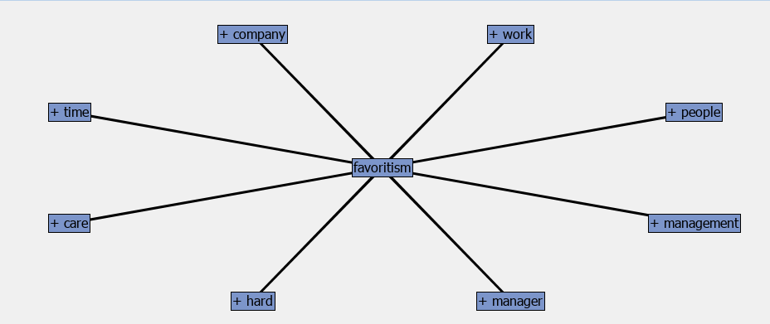
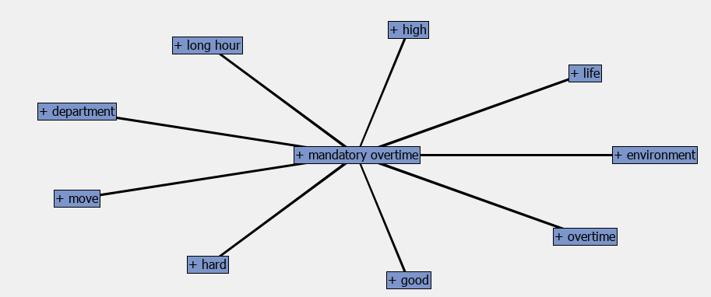
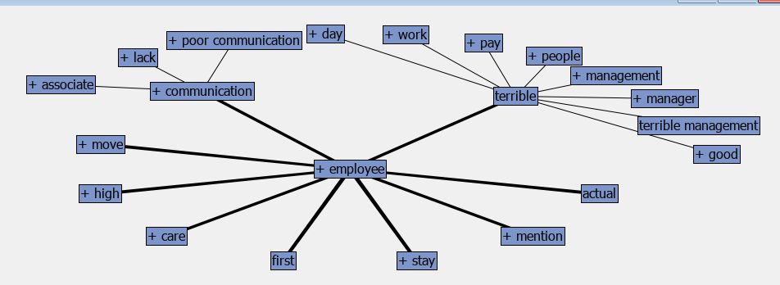
Key Concept Links

Slide 27
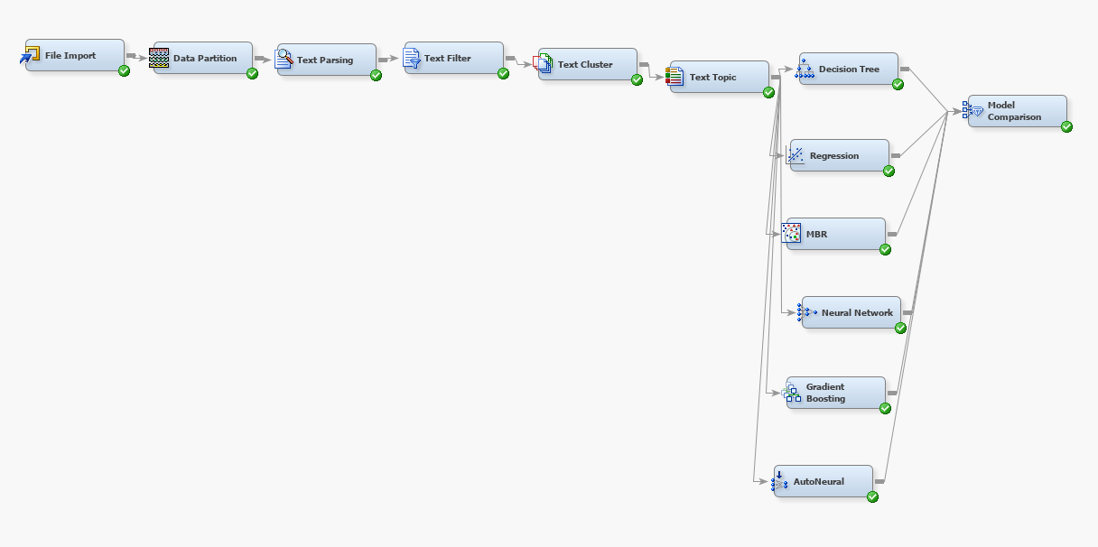
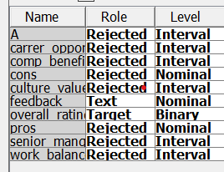
Modeling: Microsoft Reviews

Slide 28
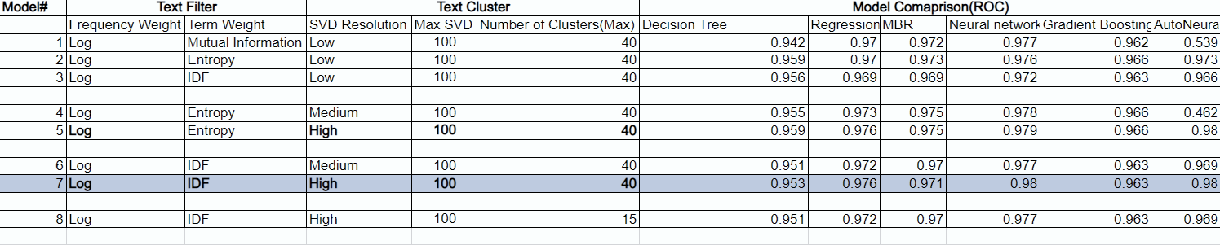
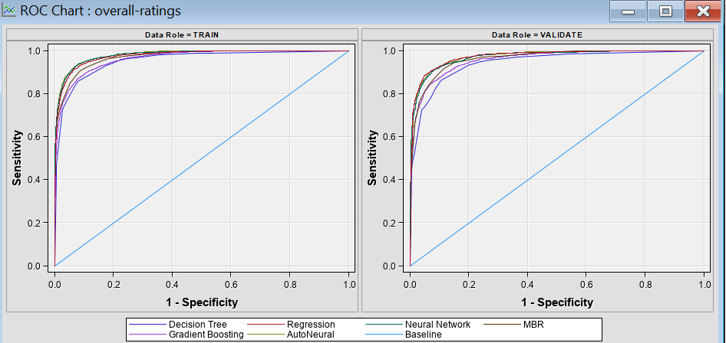
Model ROC

Slide 29
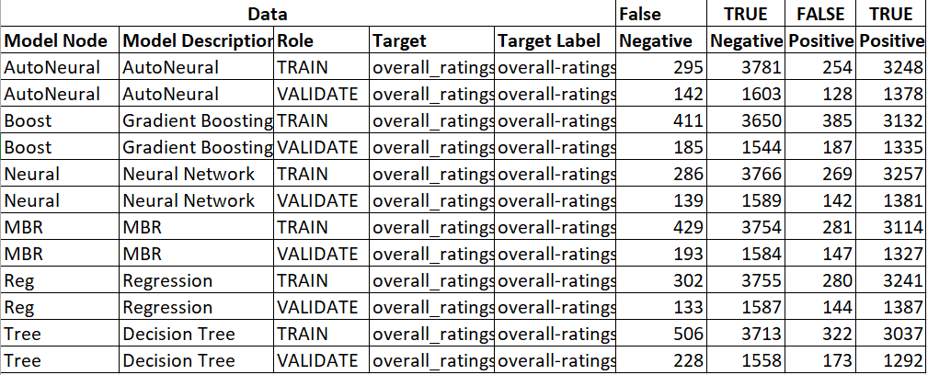
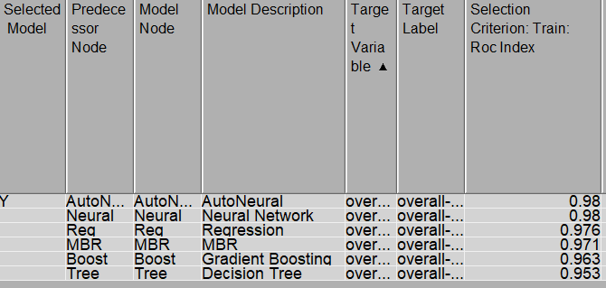
Confusion
Matrix

Slide 30
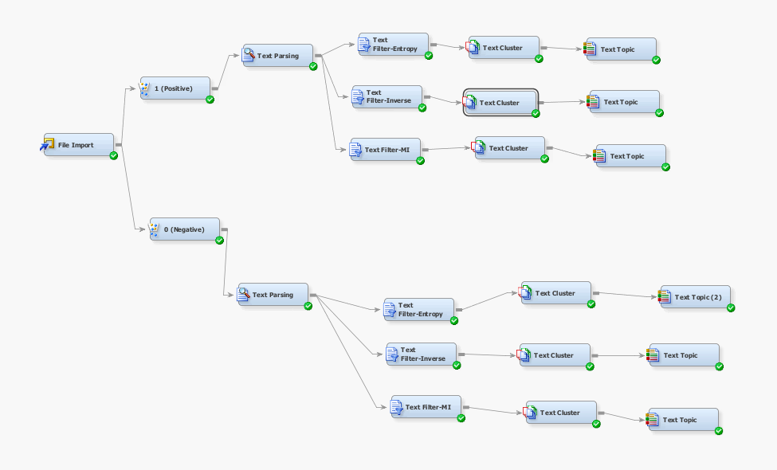
Microsoft Reviews Analysis

Slide 31
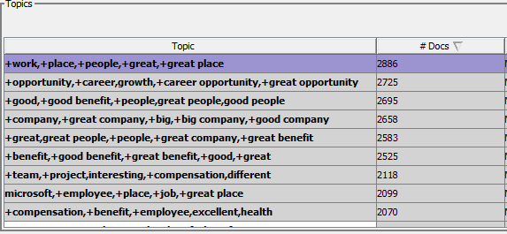
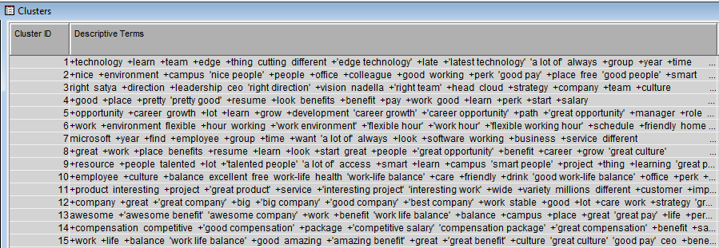
PROS

Slide 32
Text Cluster Analysis
Cluster Theme | Descriptive Terms
Career Growth | +opportunity +career growth +lot +learn +grow +development 'career growth' +'career opportunity' +path +'great opportunity' +manager +role +move 'a lot of'
Work Environment | +work +environment flexible +hour working +'work environment' +'flexible hour' +'work hour' +'flexible working hour' +schedule +friendly home +time +colleague +challenge
Compensation + Benefits | +compensation competitive +'good compensation' +package +'competitive salary' 'compensation package' +'great compensation' +benefit +salary +good flexibility +bonus excellent +'great benefit' work-life
Interesting Projects | +product interesting +project +'great product' +service +'interesting project' 'interesting work' +wide +variety millions different +customer +impact +problem +move
Job Security | +job security 'job security' 'great job' +'job opportunity' stable +easy +find +role +pay +want fun +stability +care
Smart People | +smart +people 'smart people' +team +'great benefit' +benefit +'good benefit' +great +project +'interesting project' +'flexible hour' +'work environment' +talent

Slide 33
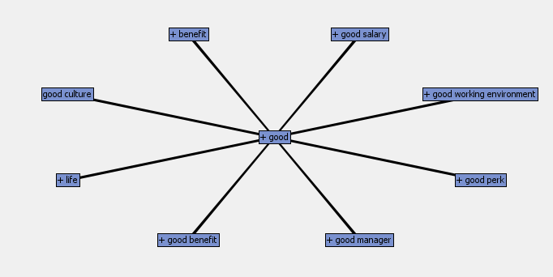
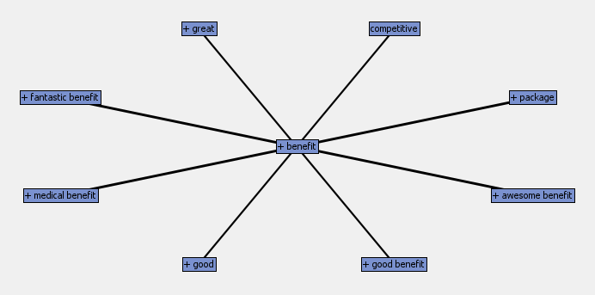
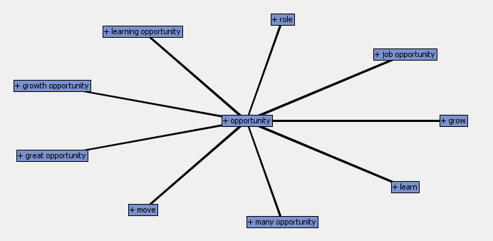
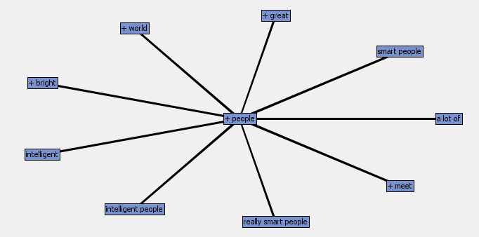
Key Concept Links

Slide 34
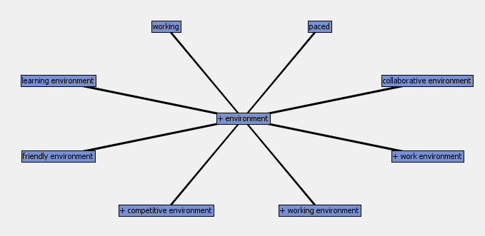
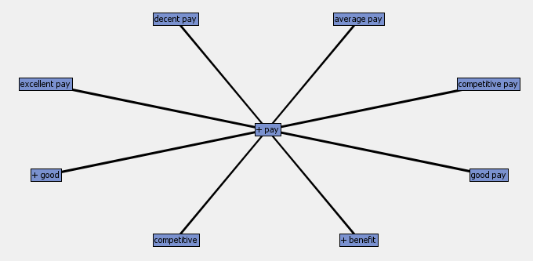
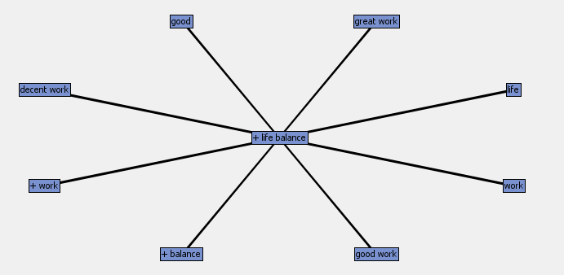
Key Concept Links

Slide 35
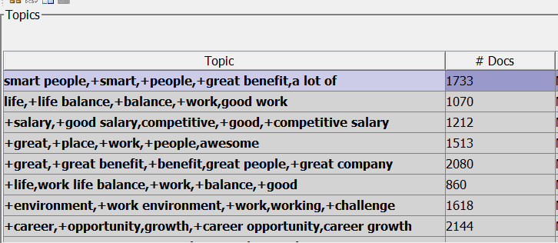
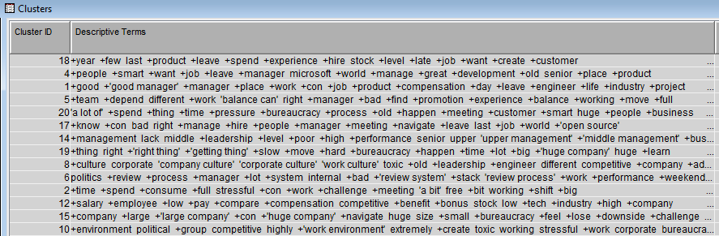
CONS

Slide 36
Text Cluster Analysis
Cluster Theme | Descriptive Terms
Stressful Environment | +time +spend +consume +full stressful +con +work +challenge +meeting 'a bit' free +bit working +shift +big
Slow Career Growth | growth +career +opportunity +slow 'career growth' +limit limited +path +advancement 'slow growth' +'growth opportunity' +'career path' +'career opportunity' +grow +development
Long shifts | +hour +long +'long hour' working +'long working hour' +'work hour' +work retail +weekend +week +expectation stressful +expect +shift +late
Poor Leadership | +management lack middle +leadership +level +poor +high +performance senior upper 'upper management' +'middle management' +business +review +system
Toxic Work Environment | +culture corporate 'company culture' 'corporate culture' 'work culture' toxic +old +leadership +engineer different competitive +company +advancement politics

Slide 37
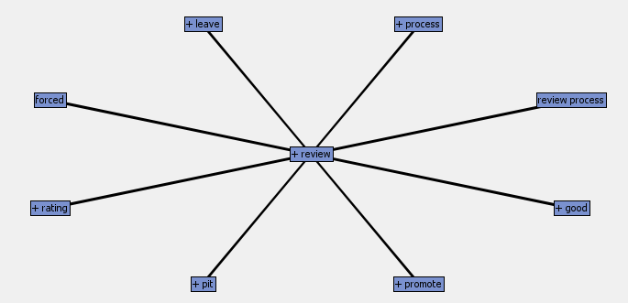
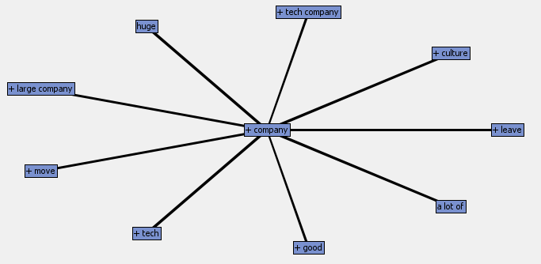

Key Concept Links

Slide 38
Discrepancies
Career Growth in Pros : Frequency: 1013 #documents : 2725 Career Growth in Cons: Frequency: 560 #documents : 2144
Compensation(High) in Pros : Frequency: 547 #documents : 2118 Compensation in Cons(Low): Frequency: 726 #documents : 1212

Slide 39
Conclusion
Amazon:
IN CONCLUSION:
Amazon Pros : Benefits(401K, Insurance, Stock options) , No dress code, Fast pace/Innovation, Customer focus/obsession, Team +Leadership, Cutting edge technology, Smart people, Friendly + Flexible staff/environment, Work environment/culture emphasis, Good salary + Benefits
Amazon Cons : Poor Management (Politics + Favoritism), Shifts : Night shift, Rotational, Peak + Holiday Season extra hours, Fast paced + Stressful Environment, Mandatory Overtime, Long work hours (Physically demanding) and short breaks, Bad Work life balance, Slow career growth/promotion opportunities.
Microsoft: IN CONCLUSION:
Microsoft Pros : Lot to Learn, Great opportunities, Flexible work environment, competitive compensation, good bonuses, interesting and impactful projects, Job Security, Smart and intelligent people
Microsoft Cons : full stressful, slow career growth, less career opportunity, long working hour, weekend, stressful expectation, lacks middle management, Corporate Culture, toxic and old leadership, politics, low compensations

Slide 40
Recommendations
Amazon:
Run marketing internal and external campaigns to advertise the Pros of the companies to retain customers(i.e. the employees) about a free culture of no dress code, Flexible timings, etc.
Work in improving in the Con's to improve the company's shortcomings and image.
Take steps to improve work life balance and share it with the company and other social media(Like Linkedin) to improve the judgement of the company
Microsoft:
Similarly, run internal and external marketing campaigns to advertise the pros. The pros would include flexible work hours, great work opportunities, etc.
Same as above, work in improving the Con's to better the company's image
Take steps to improve the image about the company on long working hours and improve stress levels among the employees

